Slide 1
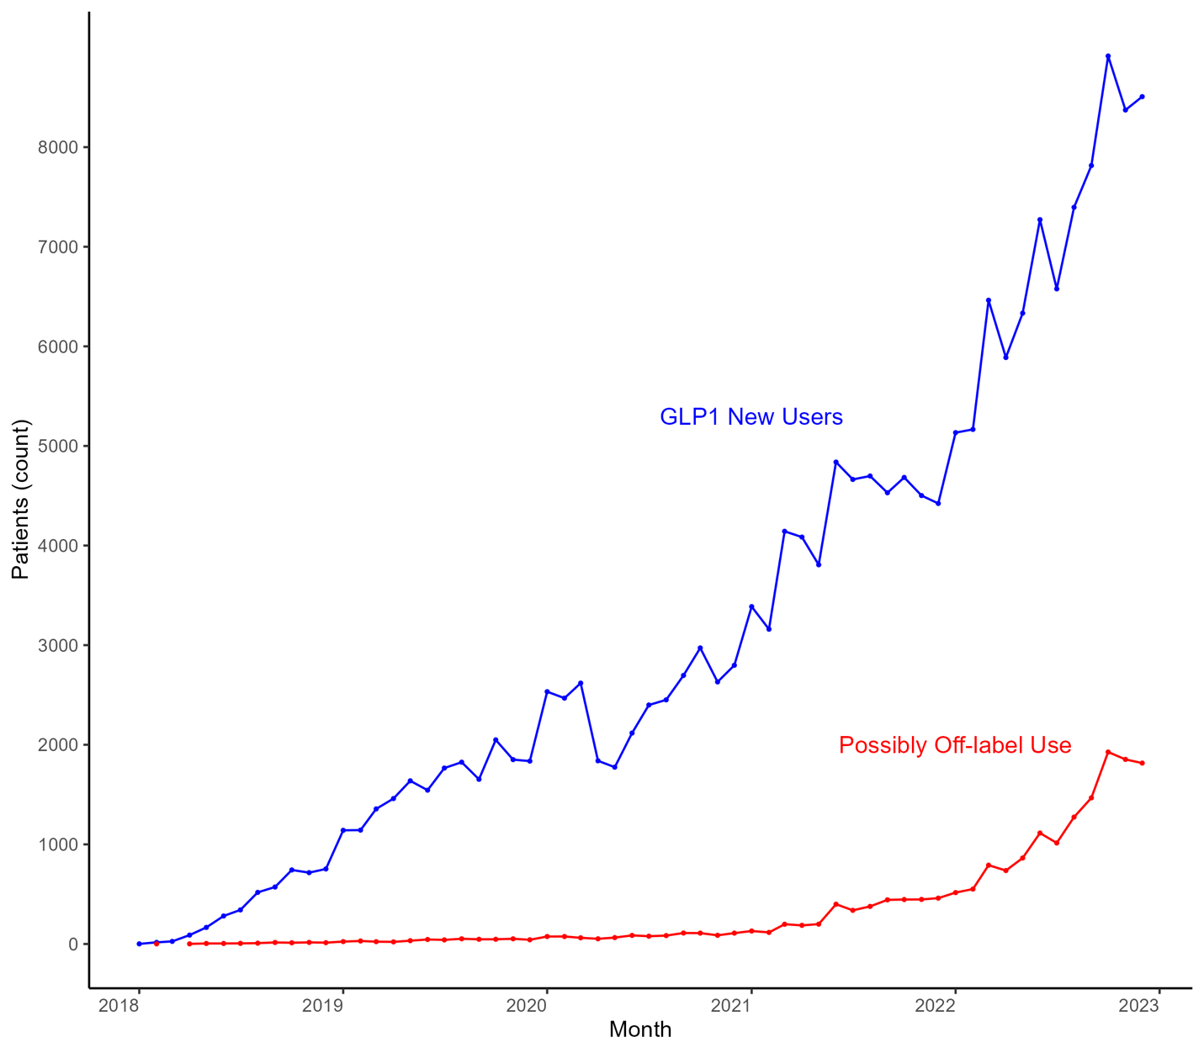
Off-Label Use of GLP-1s: Evidence from Medicare Part D
Minji Kim¹, Kieran Allsop², Xujun Gu³, Joseph Levy²
¹Department of Epidemiology, Johns Hopkins Bloomberg School of Public Health,
² Health Policy and Management, Johns Hopkins Bloomberg School of Public Health, ³University of Maryland School of Pharmacy
Purpose
Possibly Off-Label Definition
Table 1: First Fill with New GLP-1 Rx
To identify possible off-label prescribing of Glucagon-like peptide-1 receptor agonists (GLP-1s) and estimate the association with utilization management in Medicare Part D from 2018-2022.
N=187,544 Traditional Medicare Beneficiaries with Part D, we identify Possibly Off-Label use as patients who
Had more than two diagnosis records in TM claims (outpatients, inpatients, carriers, and home health agencies) on different dates within 1 year prior to the first fill;
Have no previous non-GLP-1 diabetic medication fill at first GLP-1 fill date at or prior to first fill;
Both (1) AND (2), N=25,505 (13.6%);
Had (3) and no diagnosis or non-GLP1 diabetic fill within 1 year following the first GLP-1s fill, N=19,193 (10.2%)
 | Evidence of Diabetes | Possibly Off-Label | P-Value
N | 168,351 (89.8%) | 19,193 (10.2%)
Ozempic Rybelsus Mounjaro | 79.8% 17.9% 2.4% | 79.2% 12.4% 8.4% | <0.001
Ozempic Strength 2mg/1.5ml 4mg/3ml 8mg/3ml | 81.0% 18.4% 0.6% | 85.9% 13.2% 1.0% | <0.001
Days Supply | 45.8 (23.9) | 43.1 (21.2) | <0.001
OOP Costs | $42 | $47 | <0.001
Gross Rx Cost | $921 | $954 | <0.001
Part D Plan GLP-1s Coverage Prior Auth Step Therapy | 92.2% 5.0% 2.7% | 92.3% 2.3% 1.8% | <0.001 <0.001 <0.001
Age | 67.5 (9.5) | 65.0 (10.2) | <0.001
Female | 55.7% | 74.5% | <0.001
White | 75.7% | 79.9% | <0.001
Comorbidity Obesity Hypertension Acute MI Heart failure Stroke Alzheimer’s | 10.4% 15.4% 4.4% 16.7% 11.5% 1.1% | 17.4% 5.8% 1.2% 6.2% 5.1% 0.2% | <0.001 <0.001 <0.001 <0.001 <0.001 <0.001
Background
The rising use of Glucagon-like peptide-1 receptor agonists (GLP-1s) and the current restriction on Medicare's coverage of these drugs for “cosmetic purposes” may encourage off-label prescribing of diabetic products to treat obesity.
Understanding the extent of off-label GLP-1s prescribing and whether Part D plans are responding via increased utilization management (UM) has implications for policy and spending (the Treat and Reduce Obesity Act, is being debated in congress).
Figure 1: New GLP-1 Users in Medicare by Month (N=187,544)
GLP-1 new users
Mounjaro launches
(May 2022)
Methods and Data
Weghovy Launches
(June 2021)
Positive Semaglutide results for weight loss published
(Feb 2021)
16.6% of initiators in 2022 Possibly Off-Label*
This cross-sectional study included Medicare beneficiaries enrolled in Part D who initiated semaglutide or tirzepatide between 2018 and 2022 from a 20% sample of Traditional Medicare (TM) claims. Part D data was used to identify new GLP-1 users.
We defined possible off-label use as the absence of a diabetes diagnosis or a prescription history of non-GLP-1 diabetes medications within one year before or after the first GLP-1 fill. A diabetes diagnosis was defined as: (1) having more than two diagnosis records in TM claims (outpatients, inpatients, carriers, and home health agencies) on different dates; or (2) having a diabetes indicator (DIABETES) in the Master Beneficiary Summary File Chronic Conditions.
We used descriptive statistics to characterize the possible off-label prescription of GLP-1s and logistic regression models to estimate the association of UM with the off-label prescription. UM included prior authorization and step therapy. Models were adjusted for patient demographics, clinical characteristics, and plan characteristics (Tier, cost, and Part D coverage).
Possibly Off-label users
Conclusions and Relevance to Policy
We estimate a possible 10.8% of new GLP-1 starters in Medicare between 2018 and 2022 are taking the medication off-label. The proportion of off-label prescriptions increased from 1.9% in 2018 to 16.9% in 2022.
Possible off-label users were more likely to be obese, younger, female, white, and on Part D plans that do not have utilization management for GLP-1s. They also paid more out-of-pocket and completed 4.1 more fills on average within 6 months after their initial fill. In the adjusted regression model, the odds of a prescription being off-label were 45.4% lower if a plan had prior authorization or step therapy (adjusted odds ratio [aOR] 0.55, 95% confidence intervals [CI] 0.51 to 0.59) that calendar month.
This suggests UM might be effective at deterring off-label use which is notable given the large increase in the Prior Authorization for these drugs in 2023 (and 2024, this dynamic requires further study when newer claims data become available).
 | 2018 | 2019 | 2020 | 2021 | 2022
GLP-1 new users (N) | 4,223 | 19,262 | 29,299 | 50,921 | 83,839
Off-label uses (N, %) | 82 (1.9) | 457 (2.4) | 991 (3.4) | 3,740 (7.5) | 13,923 (16.6)
Plan with UM (N, %) | 325 (7.7) | 1,002 (5.2) | 1,871 (6.4) | 1,964 (3.9) | 3,624 (4.3)
Table 2: 6-Month GLP1 Utilization After First Fill GLP-1 Rx
 | Evidence of Diabetes | Possibly Off-Label | P-Value
N | 168,351 (89.8%) | 19,193 (10.2%)
Total fills (mean) | 4.4 | 4.1 | <0.001
Total Days Filled (of 180) (mean) | 165 | 149 | <0.001
Payer Cost (median) | $4,569 | $4,133 | <0.001
OOP Cost (median) | $135 | $145 | <0.001
Contact: mkim255@jh.edu

